Slide 1
Mrs. Kazakavich
Welcome to 2020-2020

Slide 2
MY IDEA of FUN
GARDEN
HIKE
CAMP
COOK
SWIM
TRAVEL

Slide 3
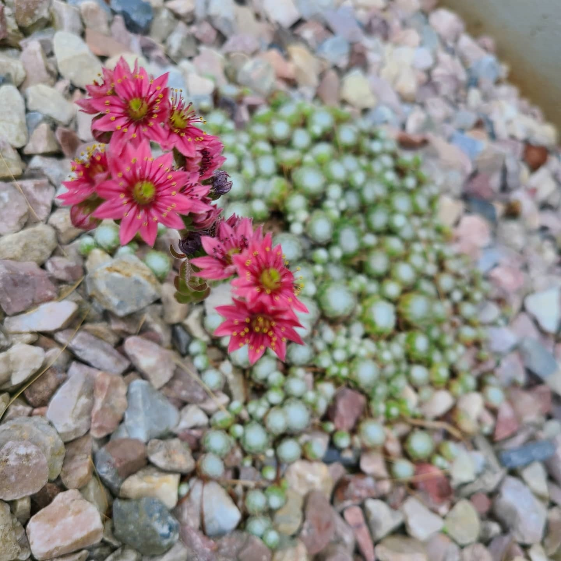
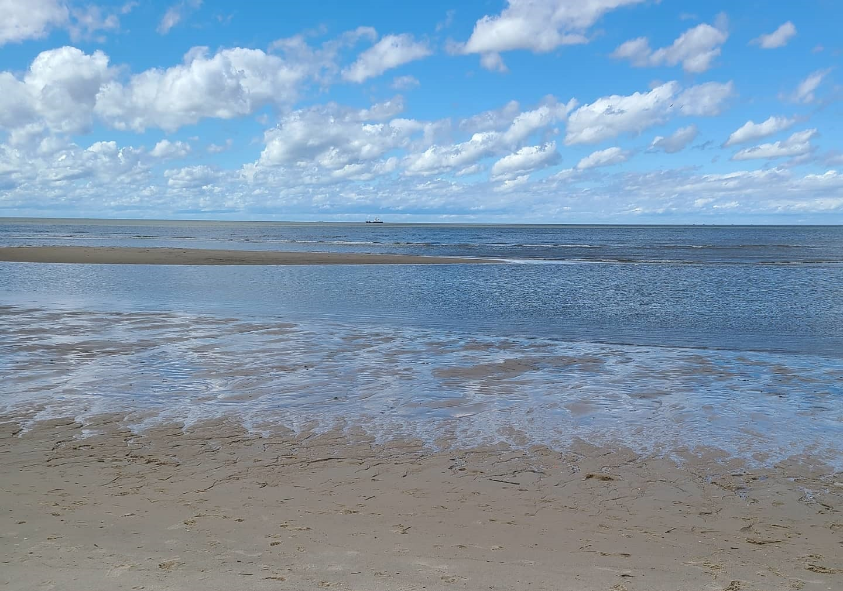
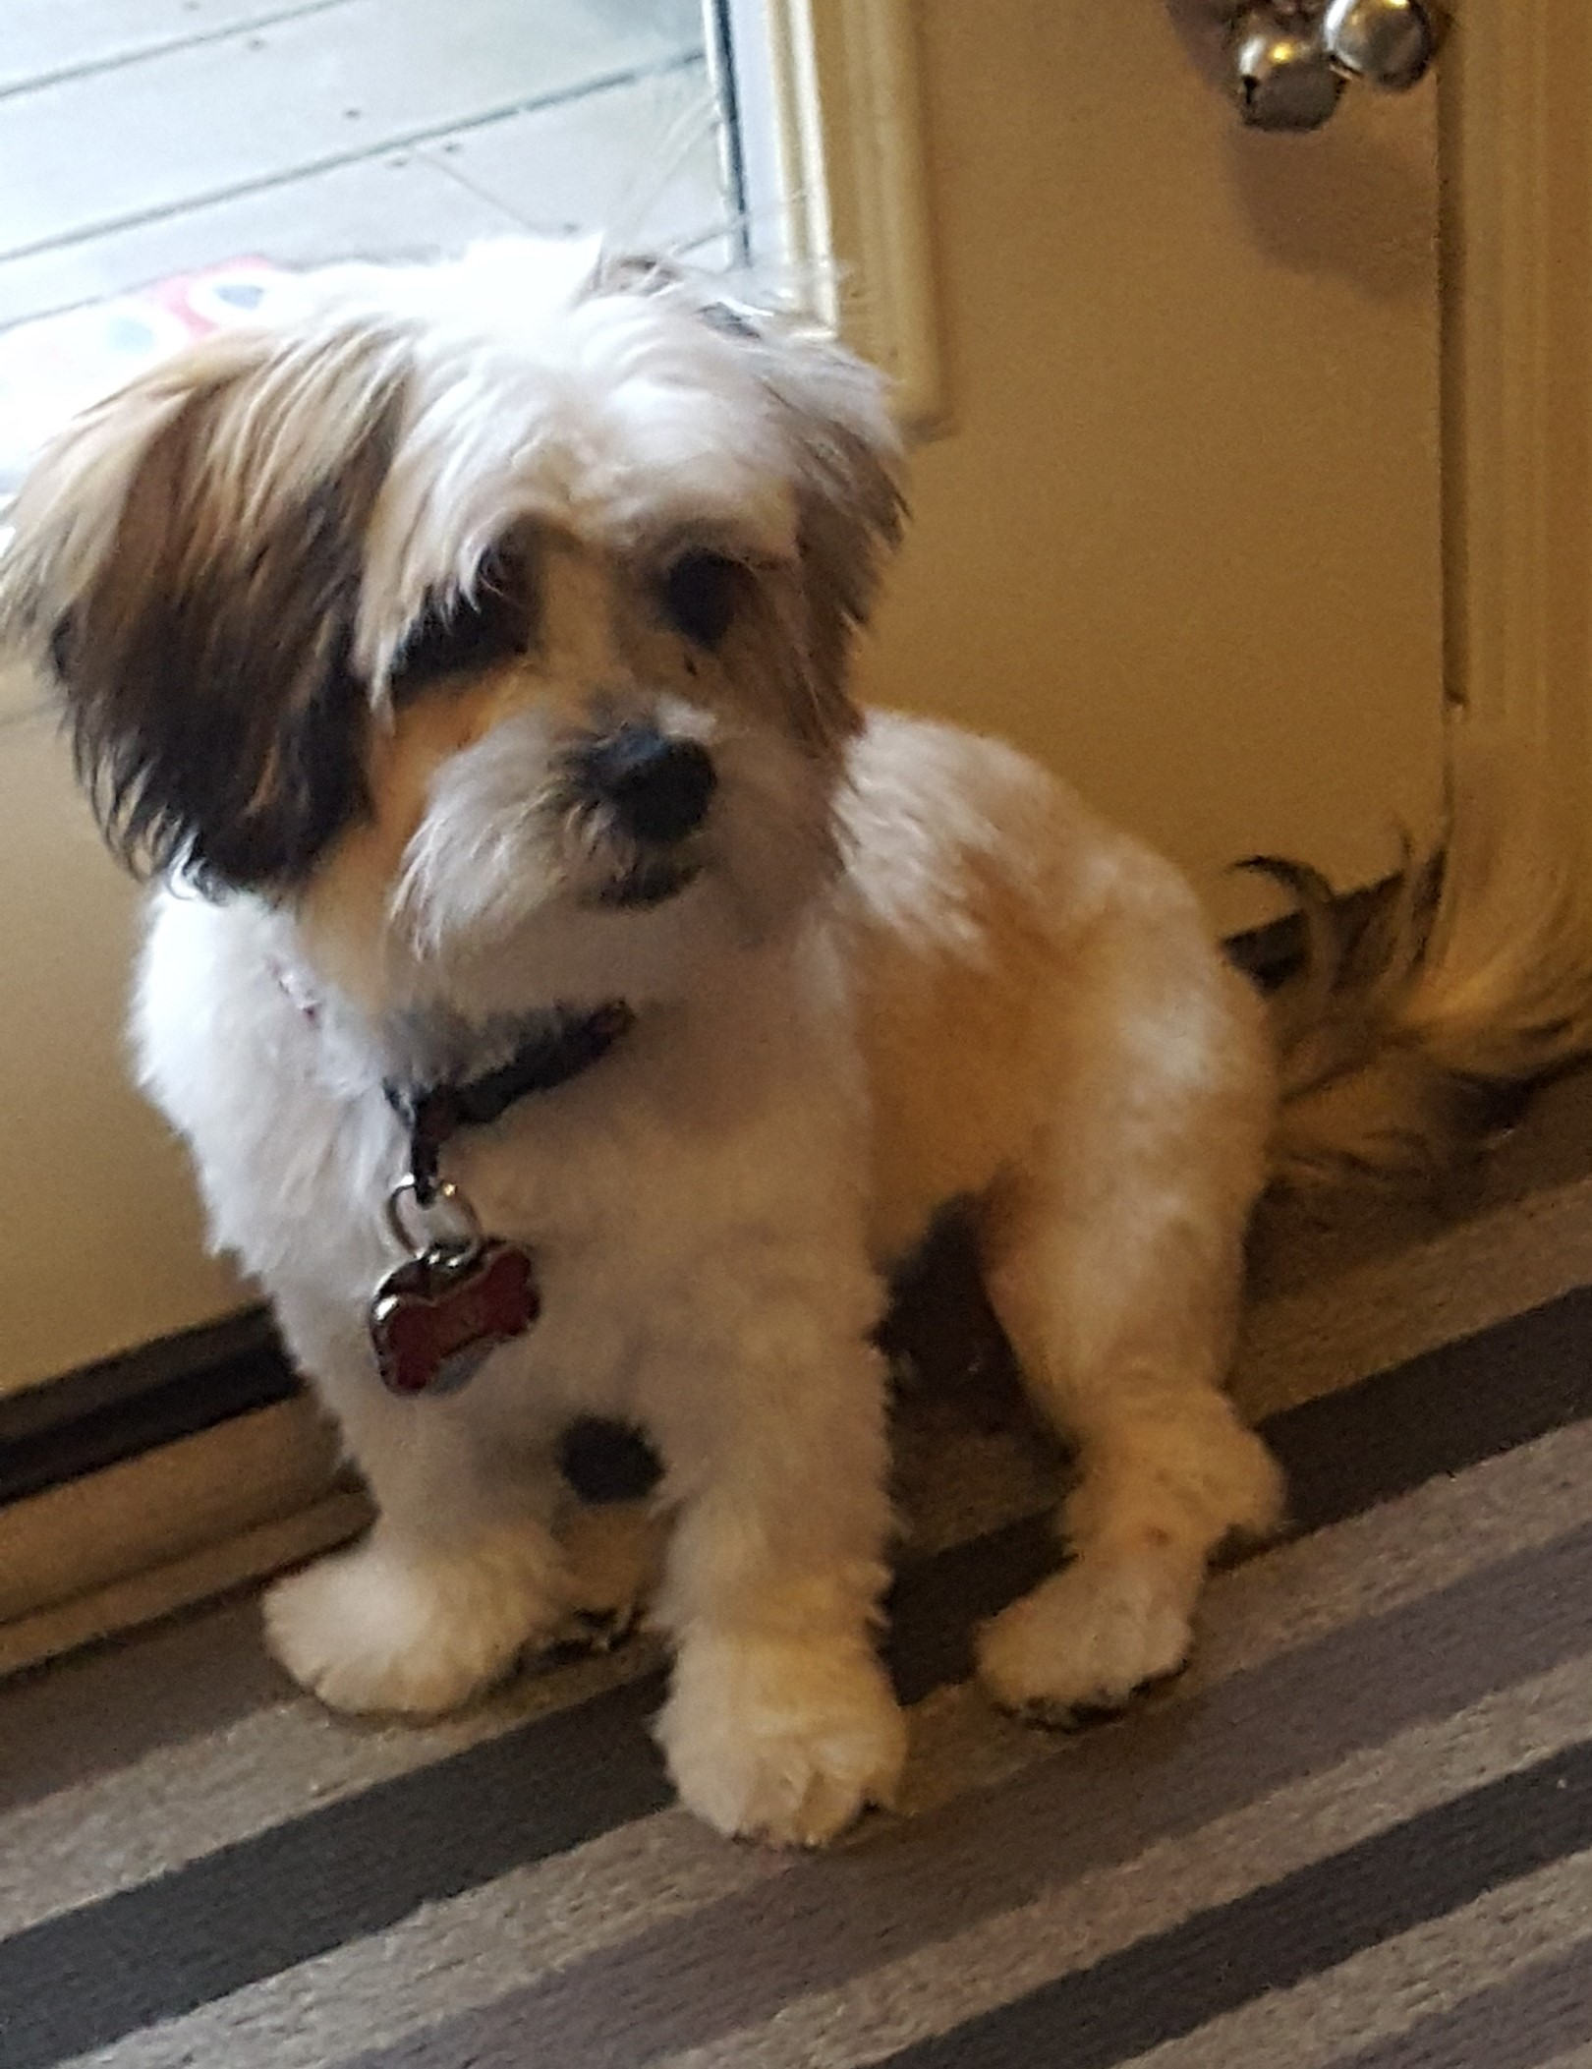
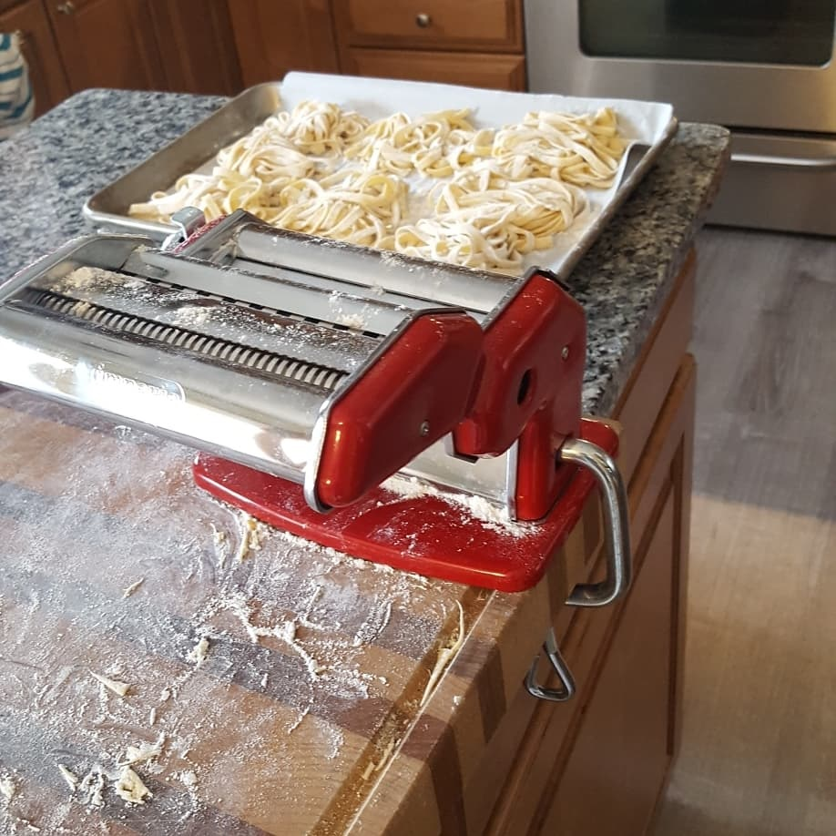

Slide 4
How I Got Here…
Millersville University- Go Ville!
Graduate
Penn State University- We Are!
Post-Graduate
Penn State
Board Certified Behavior Analyst
Undergraduate

Slide 5
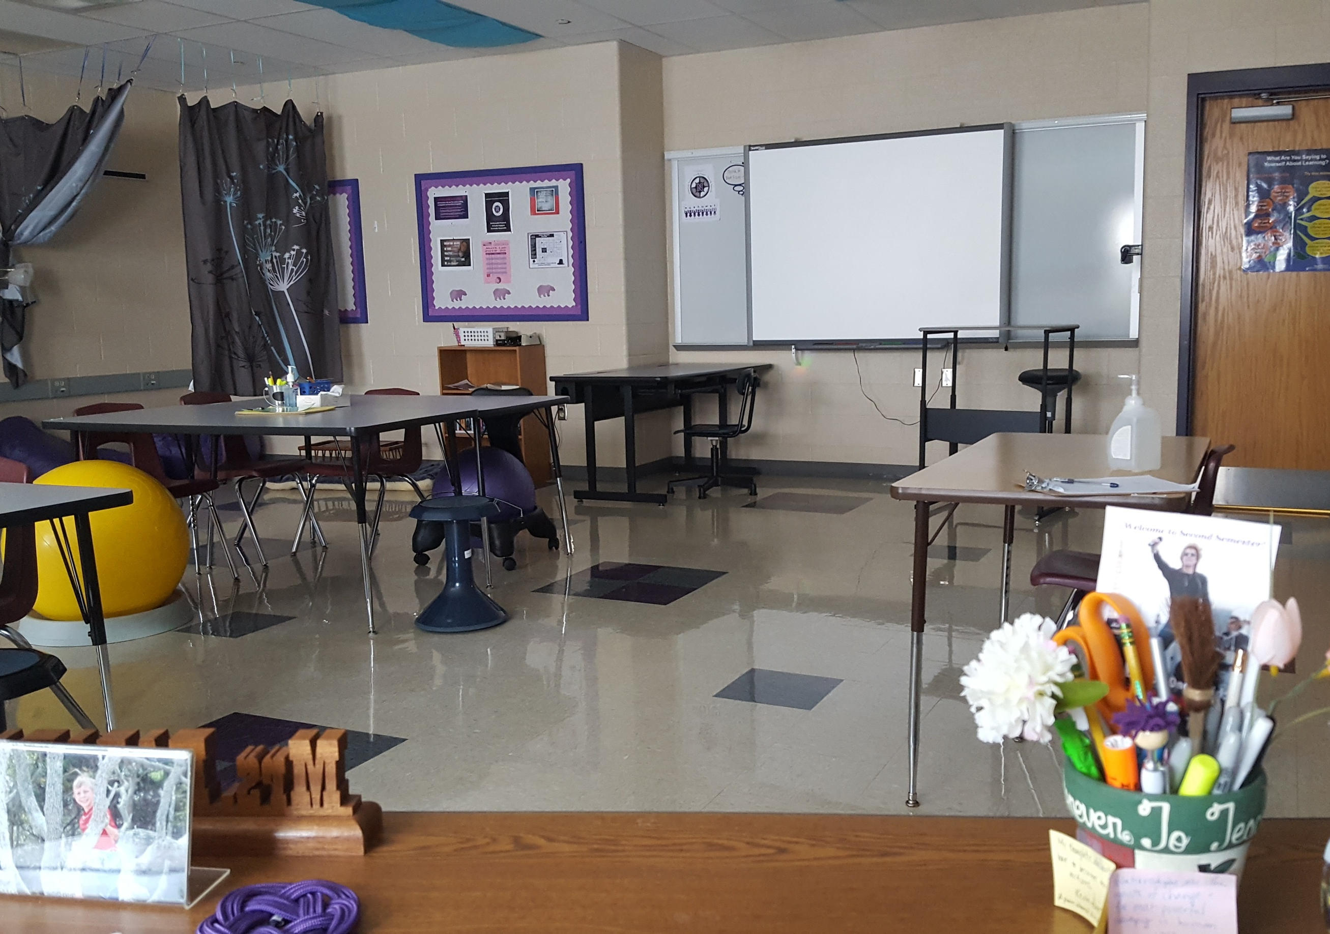
More About Me
25th year teaching in public education
5th year at Northern High School
Moved to Dillsburg in 2016 from West Hanover Township
Married for 17 years
Two Boys- 8th & 9th grades
One dog- Layla
Many plants

Slide 6
ROOM 211
Located on the first floor in the same hallway as the library
Mrs. Chung works with me in the classroom.
She has been with me for all 4 years I’ve been at Northern
Attends classes, takes notes, assists with organization, and anything we need!
She’s wonderful!

Slide 7
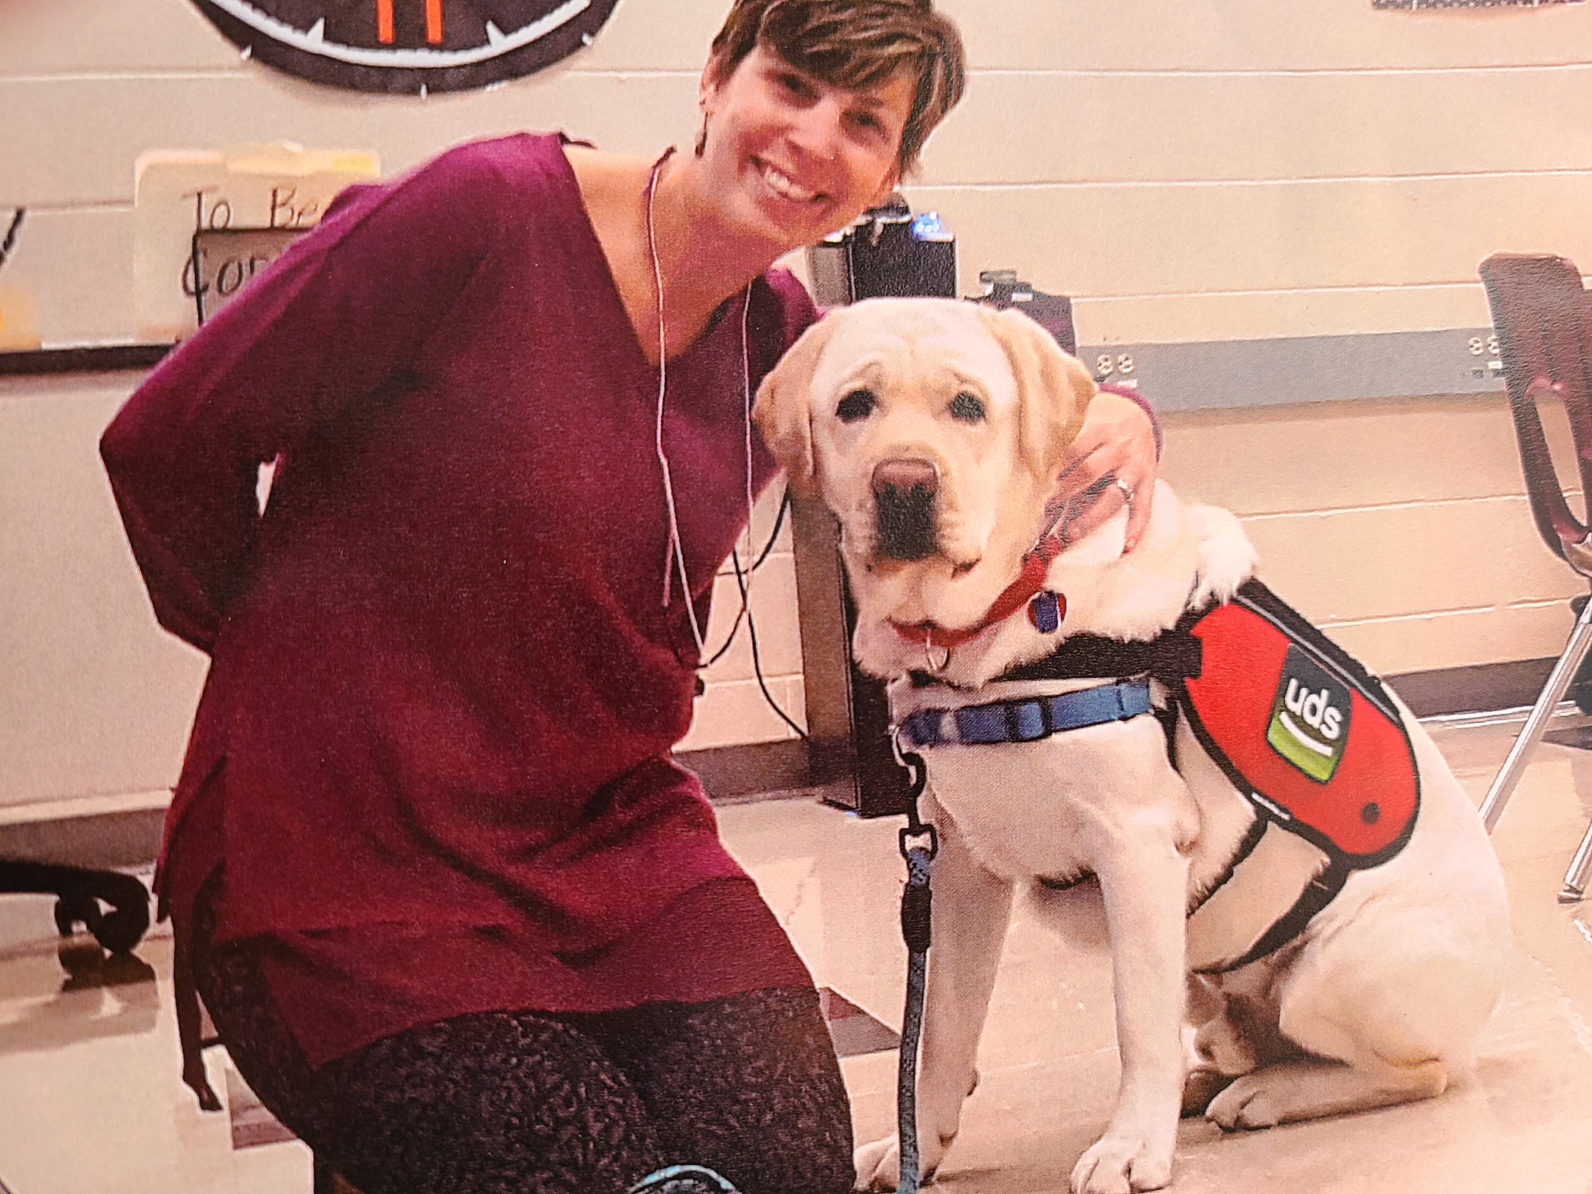
Murray and Me
Murray, our school’s facility dog, has been with us since 2017. He spends most of his time with Ms. Berry in our PACE classroom, but he gets to spend some time in room 211 when we need him!

Slide 8
CONTACT ME
rkazakavich@northernyork.org
717-432-8691 ext 2211
Office Hours: Fridays 12:30-2:30 PM on Microsoft Teams

